Slide 1
Qualification Challenges and Approaches for Cryogenic Temperature Testing of EEE Components in the ESA ARIEL Science Mission
M.SÁNCHEZ, SPCD 2024

Slide 2
Contents
ALTER presentation
Introduction & mission background
Sub-systems involved
Testing candidates and discussion
Testing Flow
Equipment Used
Testing performed so far and results obtained
Conclusion, Challenges and Further Steps
Acknowledgements

Slide 3
ALTER PRESENTATION
We are a company part of TÜV NORD Group
More than 30 years in Space business
Participated in missions such as: BepiColombo, JUICE, Solar Orbiter, Euclid, Sentinel-3, Meteosat, Galileo…
Experts in offering support in terms of Product Assurance
DLR Technical Advisors
Co-ordinate Parts Procurement Agency for many ESA missions. Recent examples are PLATO, ARIEL, EnVision & LISA
Test House, including RVT, Lot Validation Testing, Screening, DPA, RF testing and testing at Cryogenic Temperatures.
Innovative services such as DoEEEt, VirtualLab or PRECEDER

Slide 4
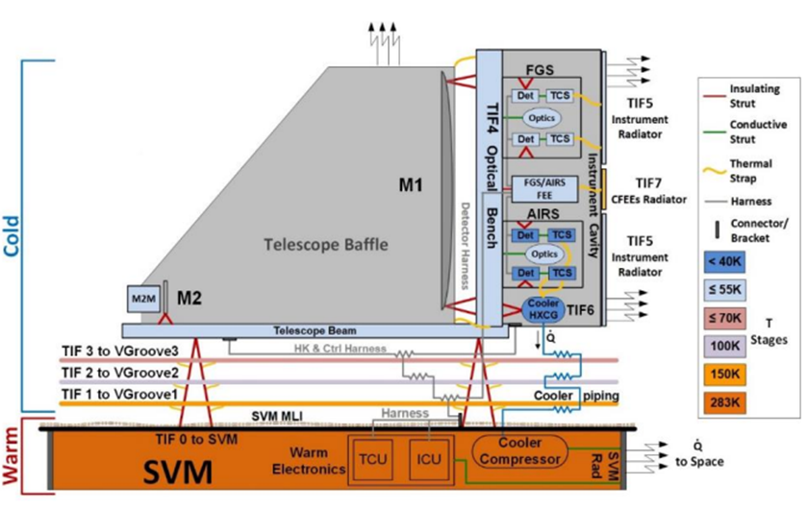
INTRODUCTION & MISSION BACKGROUND
Ariel Mission (Atmospheric Remote-sensing Infrared Exoplanet Large-survey, ESA Cosmic Vision M4)
Ariel
PLM
SVM
PLM: Cold Payload Module
SVM: Warm Service Module

Slide 5
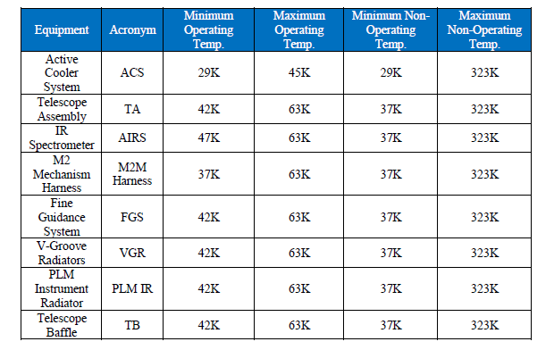
SUB-SYSTEMS INVOLVED
Ariel PLM equipment and temperature ranges to be tested:

Slide 6
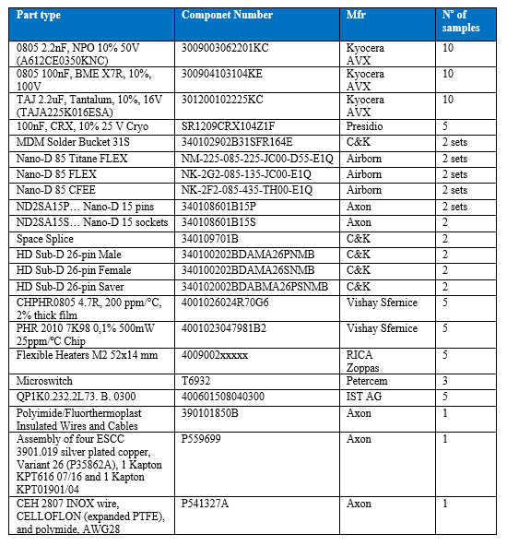
TESTING CANDIDATES AND DISCUSSION
List of candidate ítems to be tested under the umbrella of the CPPA. The selection is made to:
Temperature values seen by the parts
Family coverage
Technology corners coverage

Slide 7
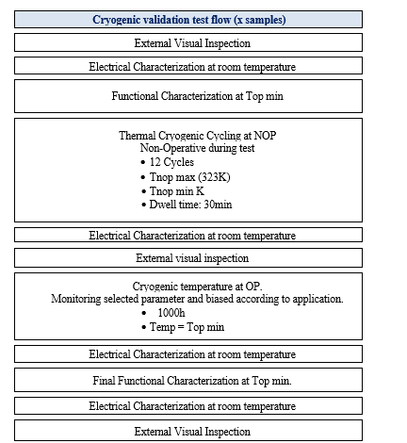
TESTING FLOW
The table shows the test Flow agreed to be performed on these components:
The 12 cycles between maximum and minimum non-operating temperature range are intended to measure the thermal stress suffered by the component just by being at those temperatures, while the test is performed under no biasing conditions.
The life test 1000h is designed to measure the fatigue suffered by the parts by working biased at the minimum operating temperature conditions. 1000h is reduced to 500h for Thermistor, Connectors and Cables.

Slide 8
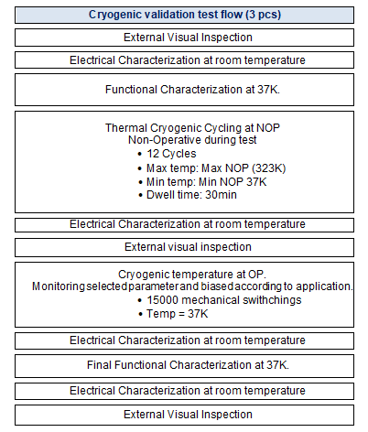
TESTING FLOW
The test flow is a bit different for the Microswitch (electro-mechanical part):

Slide 9
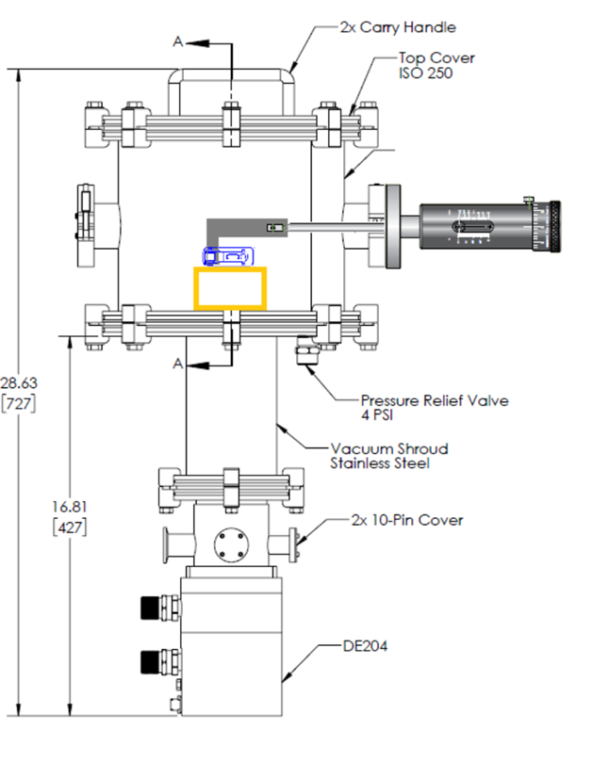
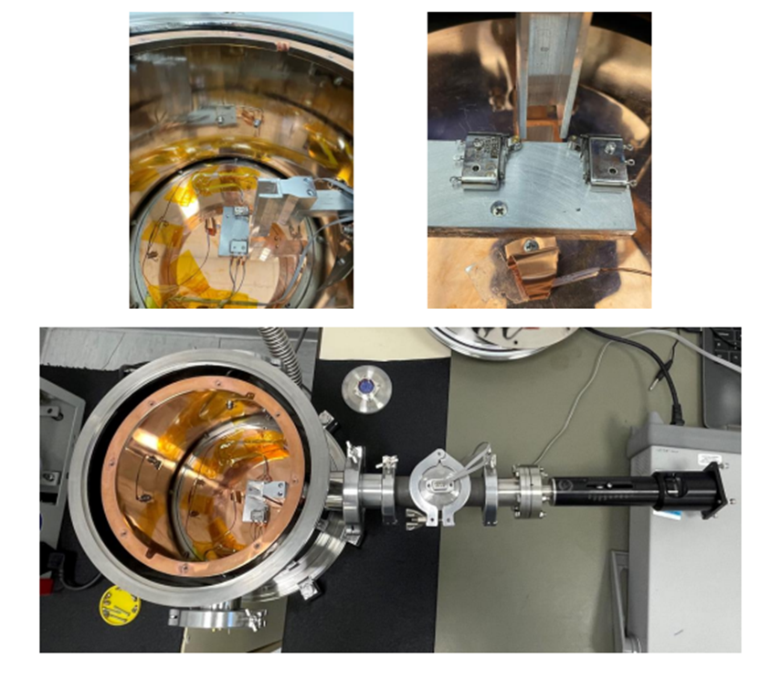
EQUIPMENT USED
The testing at these low temperaturas are performed by means of an He closed-loop cryostat with pumping system and feedthrough.

Slide 10
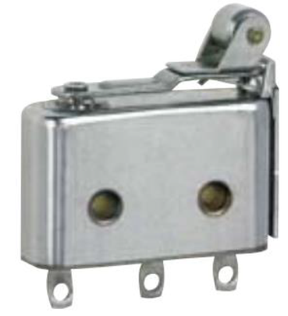
TESTING PERFORMED SO FAR AND RESULTS OBTAINED
The first test performed was a de-risking test on microswithc manufactured by PETERCEM.
Characteristic | Value | Units | Conditions
Operating Temperature | -55 to +125 | ºC
Storage Temperature | -55 to +150 | ºC
Contacts Resistance | ≤50 | mΩ
Insulation Resistance | ≥1000 | MΩ in 500 Vdc | In 500Vdc
Dielectric Strength between terminals | 500 | V | (50Hz – 1mn)
Dielectric Strength between terminals and earth | 1200 | V | (50Hz – 1mn)
Weight | ≤6.5 | g
Operating Force | ≤5 | N
Release Force | ≥1 | N
Pretravel | 0.35-0.70 | mm
Differential Movement | 0.05-0.45 | mm
Overtravel (do not exceed in use) | ≥0.20 | mm
Mechanical Life | 100,000 | Cycles
Part Number: T6932 (previously ESCC 370100302B)
Manufacturer: PETERCEM (France)

Slide 11
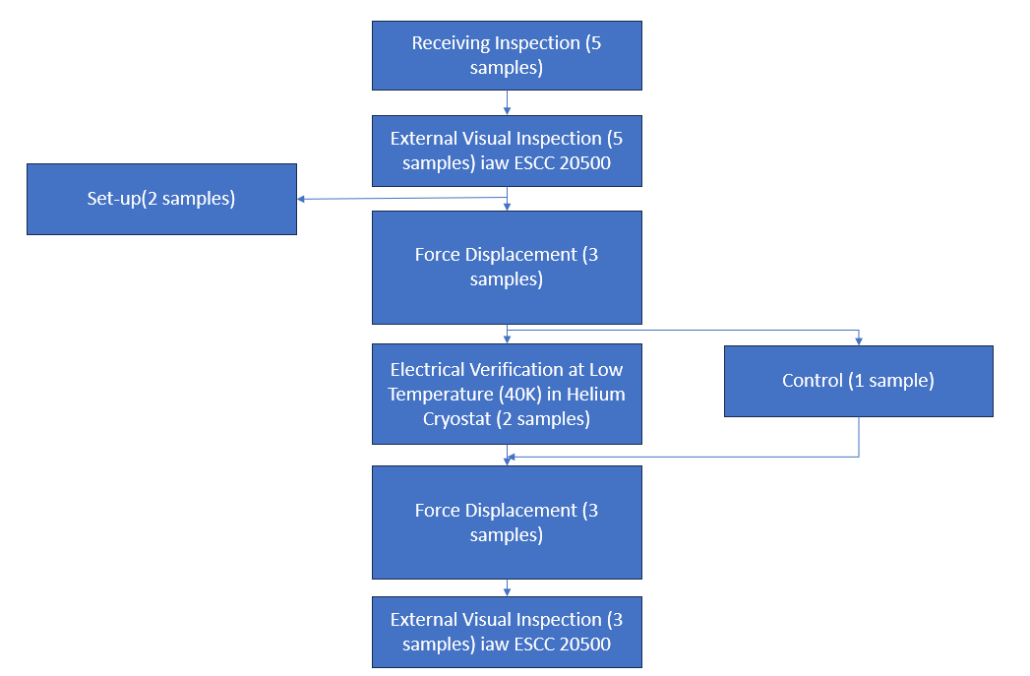
TESTING PERFORMED SO FAR AND RESULTS OBTAINED
Test Flow:
Parts Received:
Serial Number | Originally Used For
1640067 | Control Sample
1640069 | Set-up Sample
1640088 | Chart V LAT Level 3
1640091 | Chart V LAT Level 3
1640110 | Set-up Sample

Slide 12
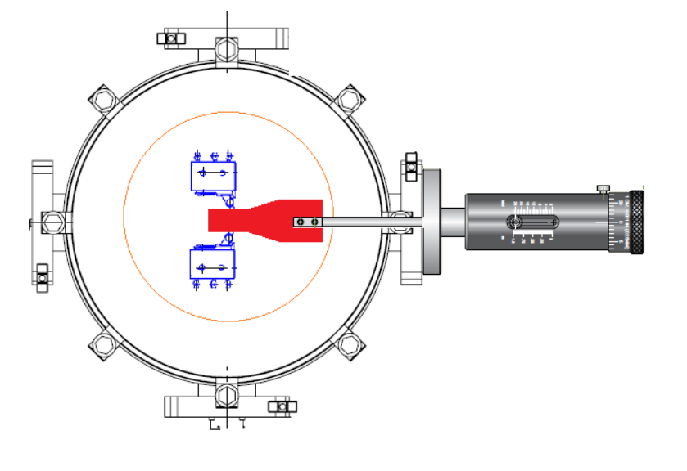
TESTING PERFORMED SO FAR AND RESULTS OBTAINED
Mounting for testing 2 Microswitches at the same time

Slide 13
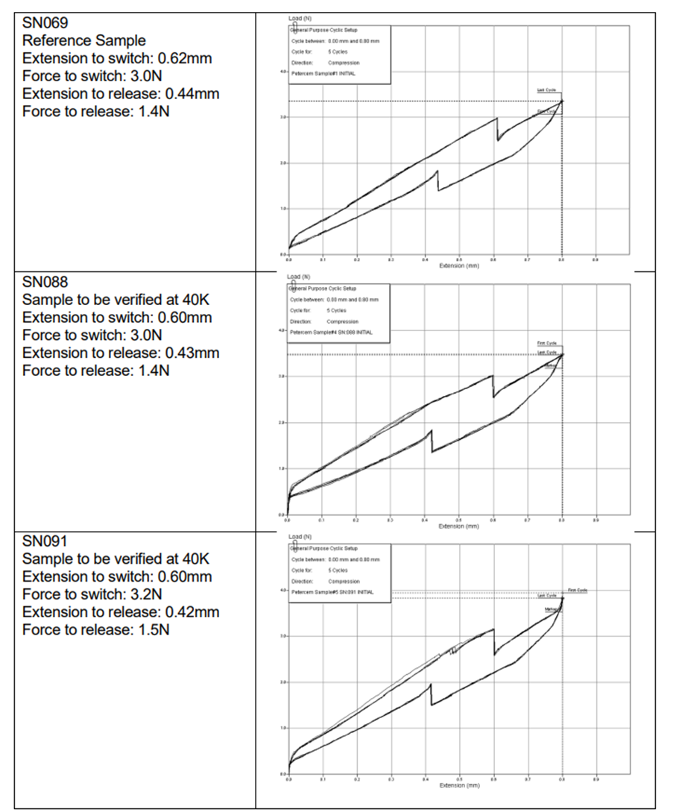
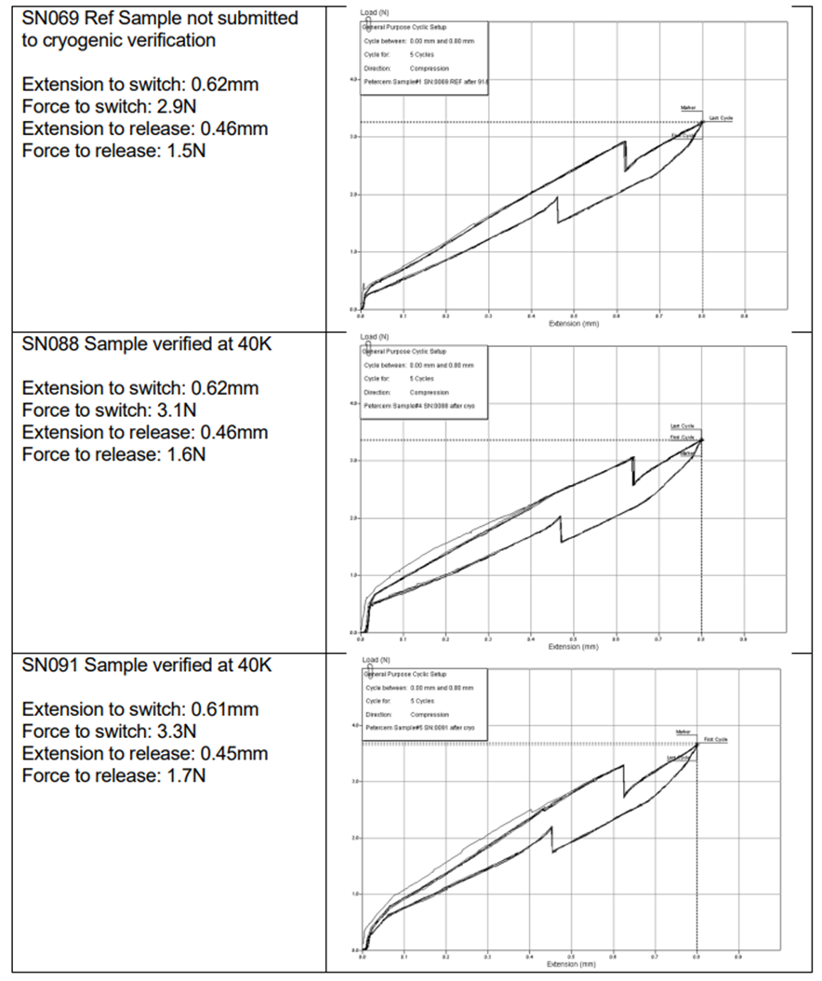
TESTING PERFORMED SO FAR AND RESULTS OBTAINED
Initial Force-Displacement Test
Final Force-Displacement Test

Slide 14
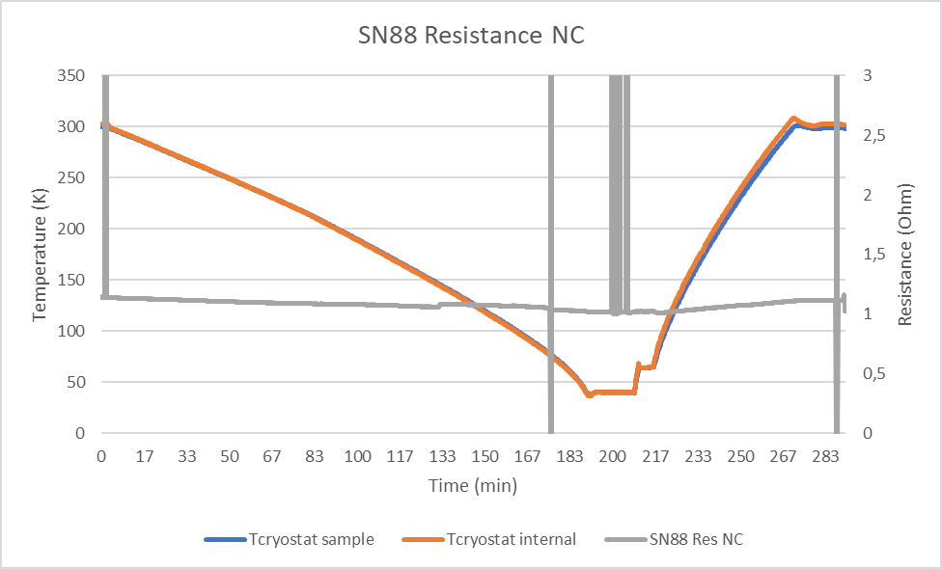
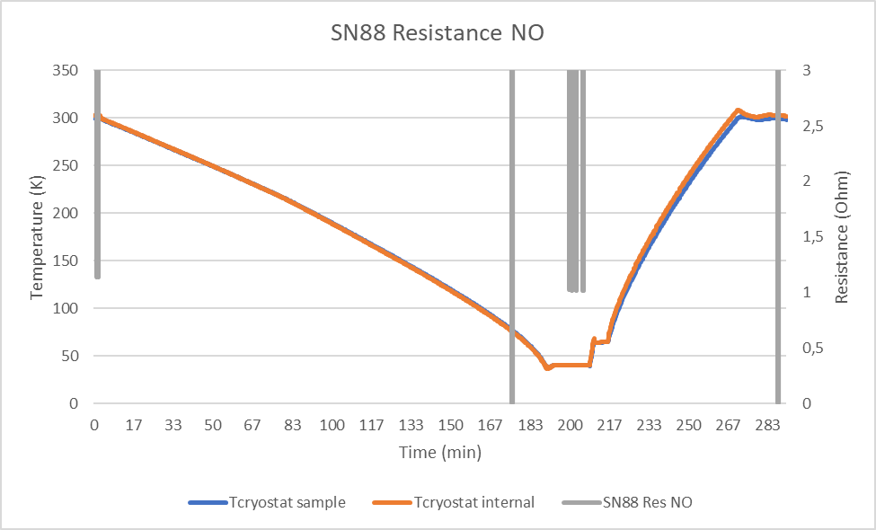
TESTING PERFORMED SO FAR AND RESULTS OBTAINED
Resistance Measurements at 40K on SN88

Slide 15
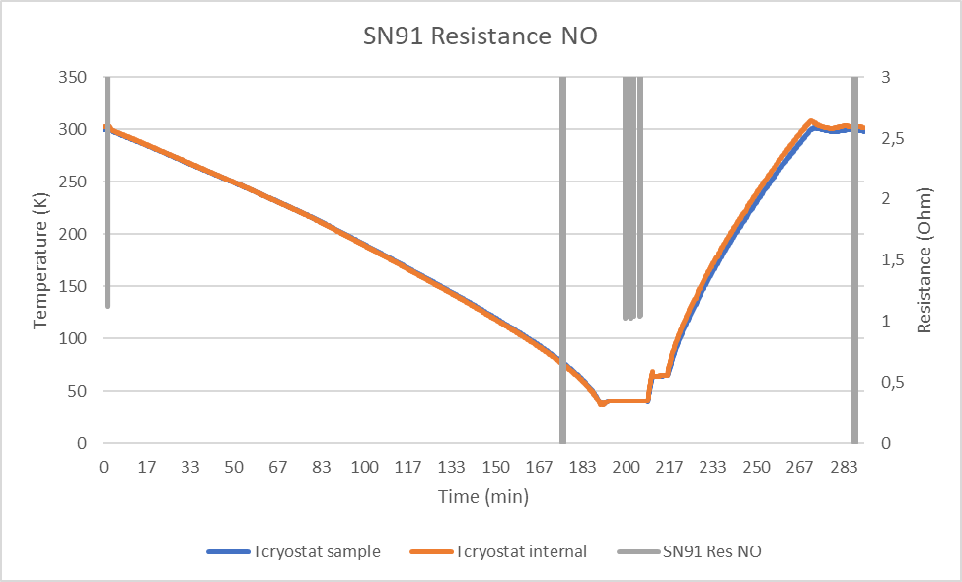
TESTING PERFORMED SO FAR AND RESULTS OBTAINED
Resistance Measurements at 40K on SN91

Slide 16
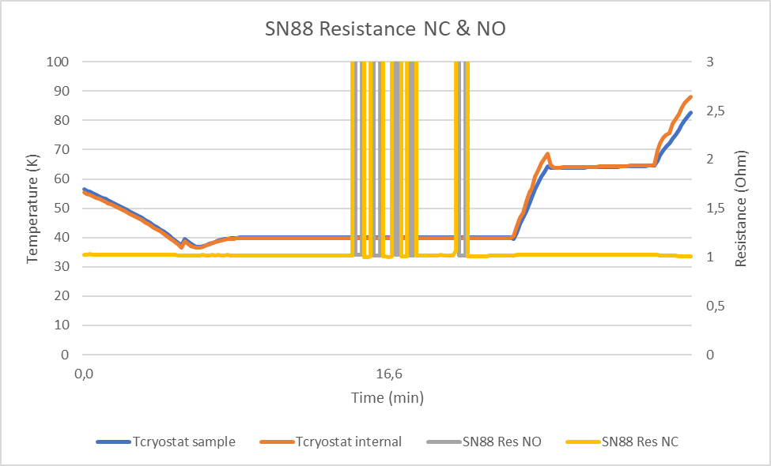
TESTING PERFORMED SO FAR AND RESULTS OBTAINED
Details on Switching cycles for SN88 & SN91

Slide 17
TESTING PERFORMED SO FAR AND RESULTS OBTAINED
Final Visual Inspection

Slide 18
CONCLUSION, CHALLENGES AND FURTHER STEPS
Test performed cannot substitute a deeper evaluation (qualification to be performed). Nevertheless, samples do not show external flaws or cracks after testing.
Samples can switch on and off at 40K. Mechanical parameters are not widely affected by the temperature decrease and recovery.
Main challenges faced are due to Schedule constraints:
On one side: huge number of parts affected by cryogenic temperatures: necessary to study thoroughly any change in Users’ DCLs in order to check all families/technologies remain covered by testing.
On the other side: 1000h life test supposes a long testing time. To speed-up testing, the use of a second cryostat working in parallel is under approval.
Next Steps: Qualification testing flow on this part and rest of candidates.
Possible small database of behaviour of European EEE passive parts to cryogenic temperatures.

Slide 19
ACKNOWLEDGEMENTS
Dr. Léo A. Farhat (ESA)
SENER Aeroespacial

Slide 20
THANK YOU FOR YOUR ATTENTION!

